Slide 1
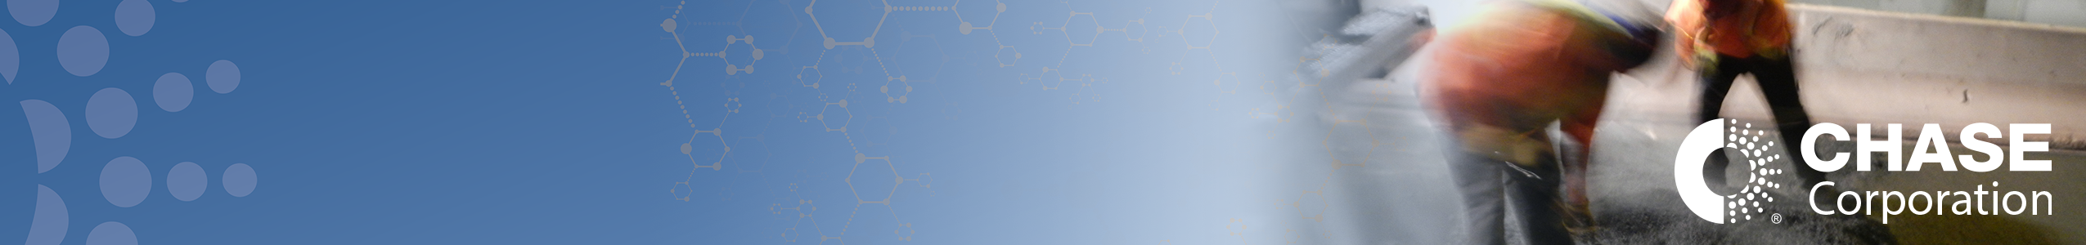
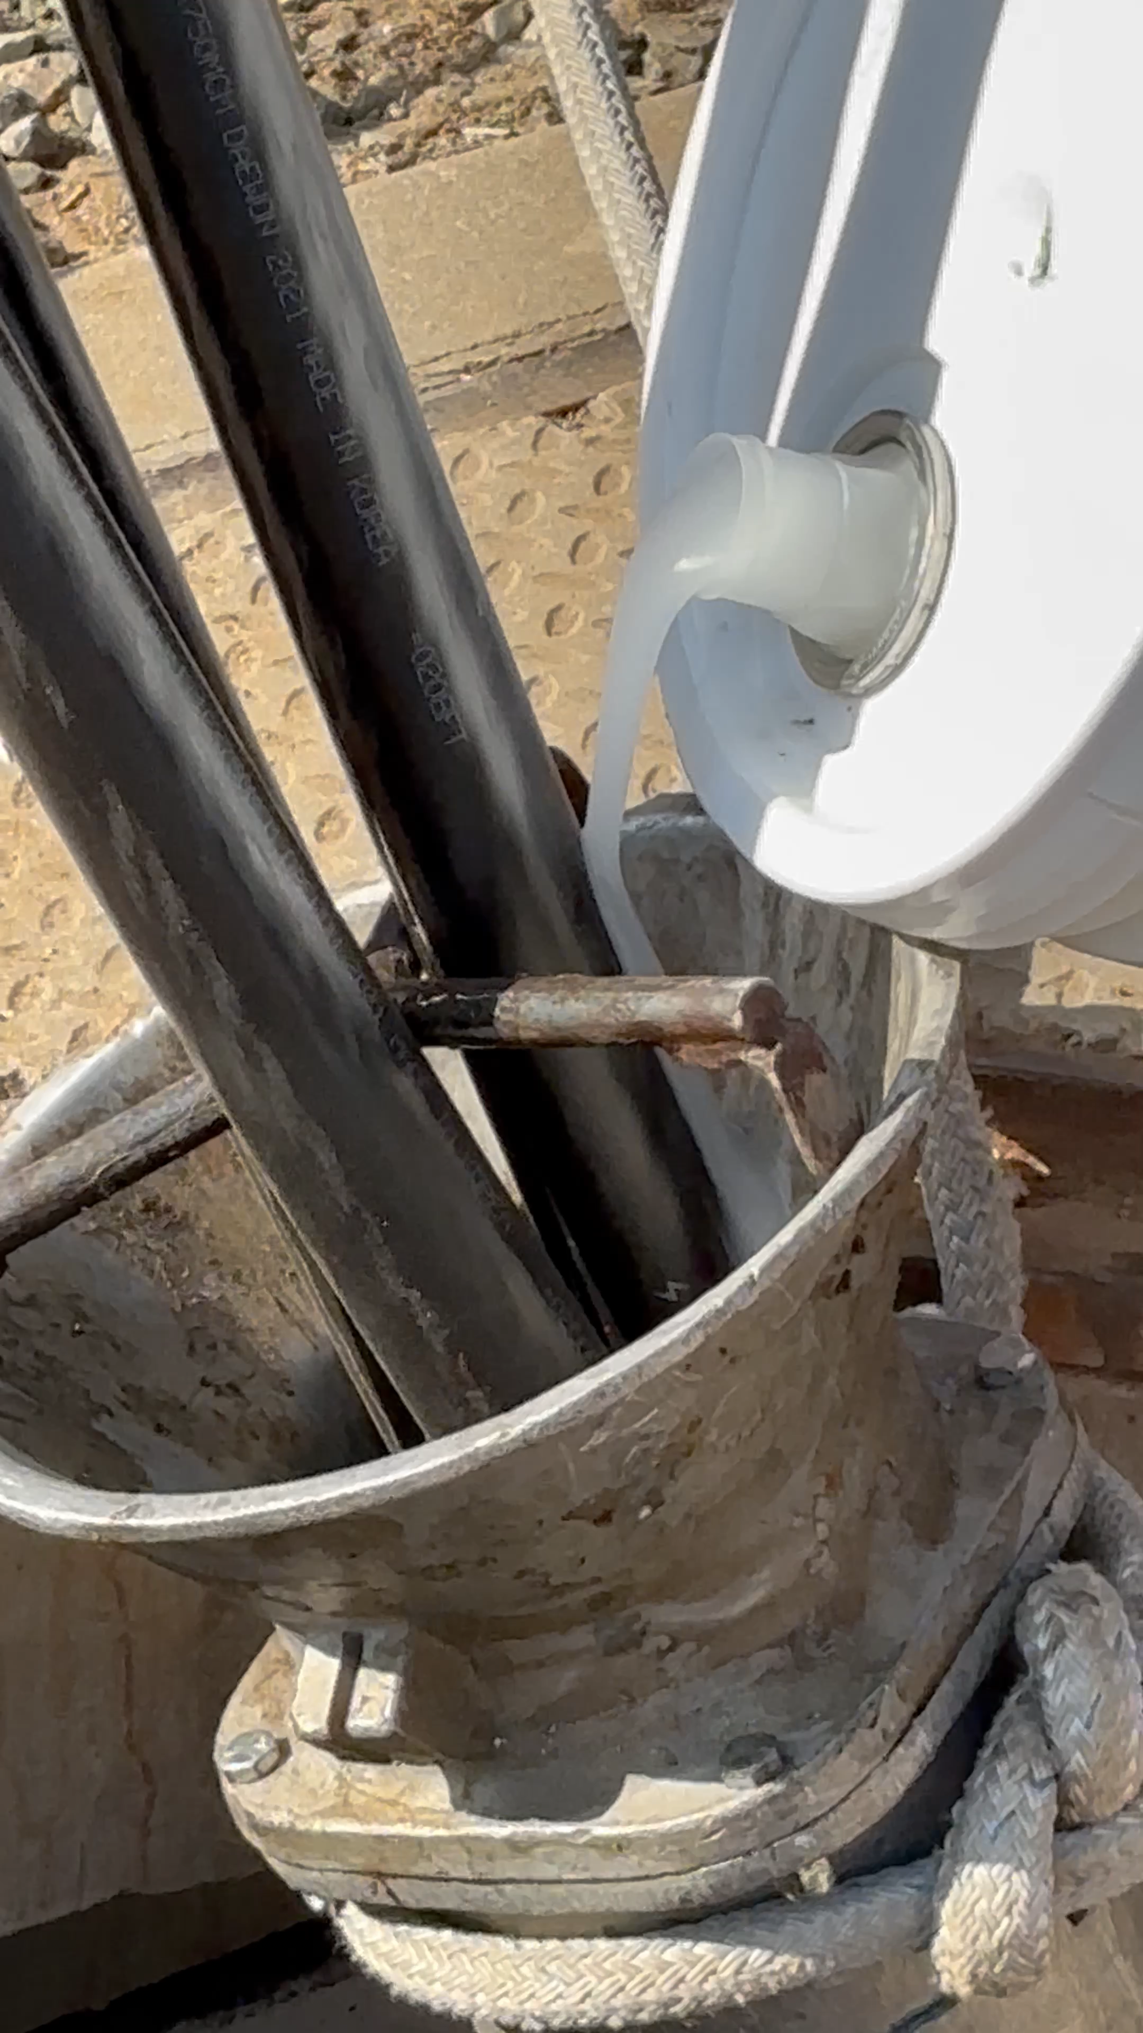
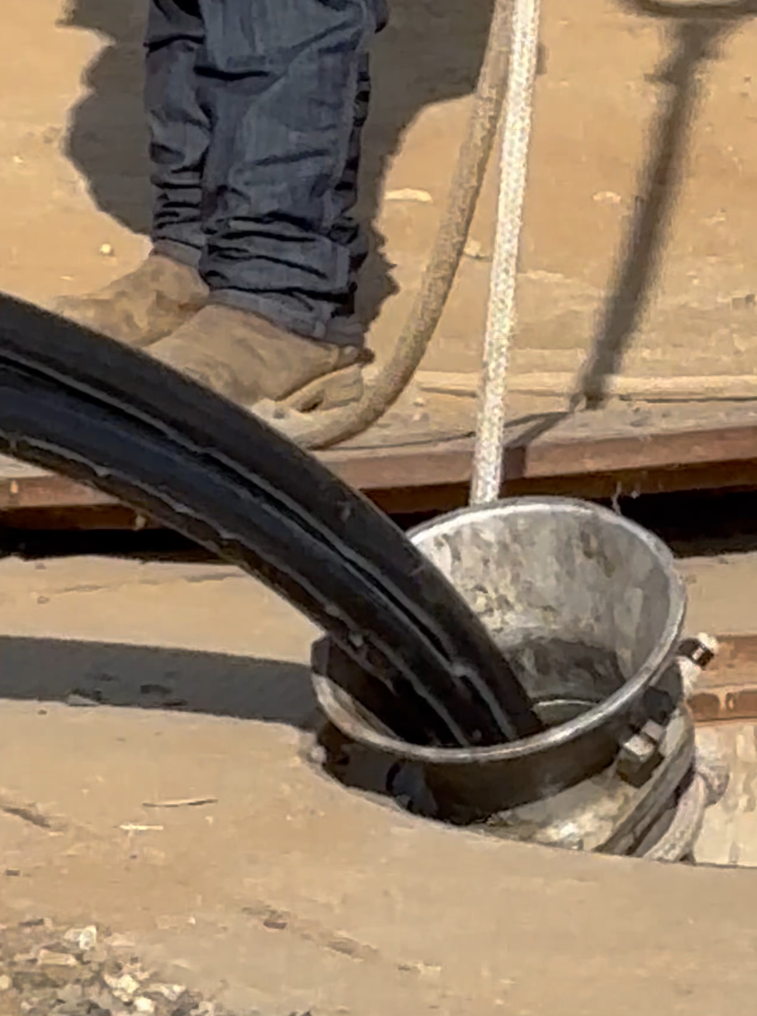

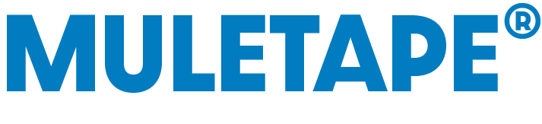

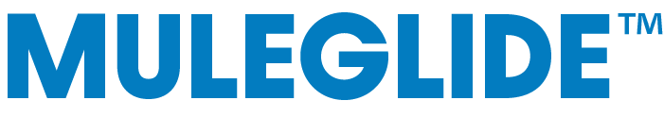
Project Name | City Of Riverside CA Muleglide field Trial
Owner | City Of Riverside
Completion Date | July 2024
Chase Products Used | Item # 75216 Muleglide Cable Pulling Lubricant Medium Viscosity 2.5 gallons used
Project Overview: | 750 MCM Tri Plex underground cable pull at COR Training Yard
Installer: | City Of Riverside install technicians
Desired Outcome: | Successful cable pull with minimal COF and clean up
Result Achieved: | COR achieved a successful pull where other products has failed. Less material required, less clean up, greater safety
Contact Information: Bprusinski@Chasecorp.com
Need More Information? Click here

Slide 2
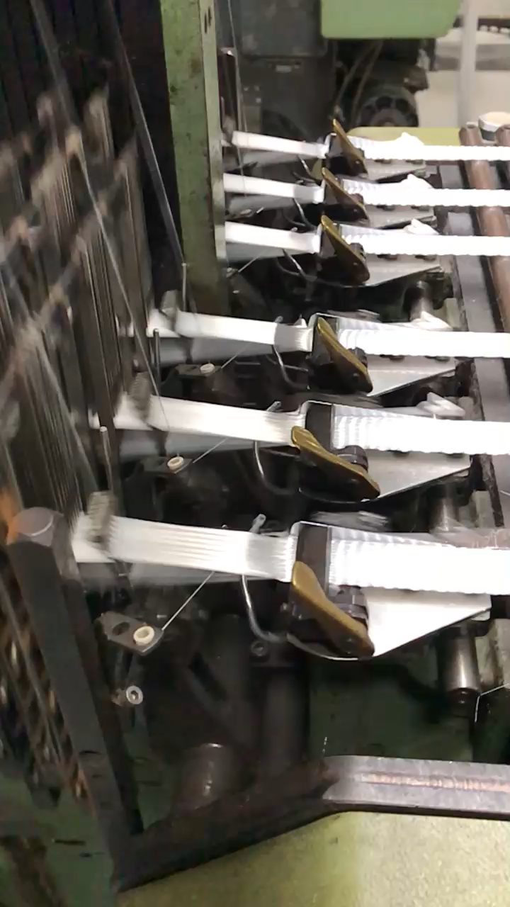
Project Name | Muletape WP2500P Manufacturing Process
Owner | Chase Neptco
Completion Date | December 2023
Chase Products Used | WP2500P 2500 Pound Woven Polyester
Project Overview: | Demonstration of Machine speed and efficiency
Installer: | Neptco Muletape manufacturing facility Hickory NC
Desired Outcome: | Demonstration video of how Muletape is woven
Result Achieved: | Muletape manufactures at 99% Quality Control
Contact Information: Bprusinski@Chasecorp.com
Need More Information? Click here

